Slide 1
Role Based Training – Developers
Authored and Presented by: Process Team

Slide 2
Document History
Version No. | Authored/ Modified by | Remarks/ Change History | Date <dd-m-yy >
1.0 | Charu Singh | Migrated to the new standard template. | 11-Apr-14
1.1 | Nitin Pangrekar | Template change and modification of a slide for process image. | 16-Mar-15
2.0 | Josmi Jose | Changes in Requirement Management System, Maintenance Life cycle, Estimation , change Management system. Added some details about Root Cause Analysis . Added notes for reference. Template change and modification of a slide for process image. | 22-Apr-16
2.1 | Sruthi Sureshbabu | Migrated to the new standard template. | 3-Apr-17
3.0 | Hrishikesh W, Nupur G, Suraj K, Rini J | Change in Q@core framework, Change in Developer-A Role, Change in all SDLC Processes, Minor changes in Project Management processes(CAR techniques) | 2-May-19
3.1 | Hrishikesh W, Suraj K | Change in Quick Test, Added a slide about DevOps, Added a slide about development metrics, updated links to videos, Added notes for suggested slides. | 18-Sep-20

Slide 3

Agenda
Quick Glance at Q@Core!
Responsibilities of Developer
Involvement of Developer in various processes
What is DevOps?
Commonly used Development Metrics
Walkthrough of Q@Core artifacts
Q & A
Copyright © 2020 Cybage Software Pvt. Ltd. All Rights Reserved. Cybage Confidential.

Slide 4
Q@Core Framework
Apex Manual
Organization information
Policies and Processes
Lifecycles and Execution Models
Roles and responsibilities
Process Manual
SDLC
Project Management
Horizontal
Business Processes
Departmental Manual
Content Services
Admin
Human Resource
Information Systems
Support Services

Slide 5
Quick Look at Processes
PROJECT MANAGEMENT
Project Kickoff
Project Monitoring
Risk Management
Causal Analysis
Project Planning
Estimation
Change Management
Project Closure
Requirement Management & Development
Design
Construction
Build and Release
Testing
Deployment
Maintenance
Configuration Management
Resource Management
Knowledge Management
Reviews
Audits
Continuous Process Improvement
Training & Development
Decision Analysis & Resolution
HORIZONTAL
Q@Core can be customized / tailored based on Project Context and need

Slide 6

Developer – A Role!
Understand and elicit the requirements
Attend Client calls
Prepare/Study design
Set-up Development Environment
Coding using appropriate Coding Standards
Reviews
Unit testing
Highlight Issues/Risks to Project Manager
Communicate with relevant stakeholders
Participate in performing Root Cause Analysis
Bug Fixing (QA defects)
Copyright © 2018 Cybage Software Pvt. Ltd. All Rights Reserved. Cybage Confidential.
Notes:
Ask their role in day to day project activities instead of reading through the points.

Slide 7

Involvement of Developers in various processes : SDLC
Copyright © 2020 Cybage Software Pvt. Ltd. All Rights Reserved. Cybage Confidential.
www.cybage.com
7

Slide 8

SDLC Processes
Requirements Management
Participate in Requirement Gathering and Understanding/Refinement
Participate in elicitation of requirement specifications
Update responded by client requirement related queries
Get requirements reviewed and agreed with client
Create and Maintain Requirement Traceability Matrix
Use of tools is recommended for requirement management
e.g. Jira, Confluence, TFS etc.

Slide 9

SDLC Processes
Design
Participate in creating/understanding design
Identify adequate design solutions/patterns
Create technical design as per standards
Get the design reviewed and agreed with client
Use of tools is recommended for designing e.g. Visual Studio, Eclipse, Visio, etc
Notes:
Design documents available on Q@Core:
AD/SSLD/UID

Slide 10

SDLC Processes
Unit Testing
Is a level of software testing where individual units/components of a software are tested
Review and execute test cases
Make use of Unit Testing Tools like nUnit, Jasmine, jUnit
Ensure to update UTCs for changes in functionality
Recommended to have module wise UTCs maintained
Note : UTC Document may not be required if Unit Testing is done using tools.
Notes:
-UTCs help in ensuring coverage of multiple scenarios
-Gives an assurance of defect-free code for further phases

Slide 11

SDLC Processes
Construction
Study the design
Write the Unit Test Cases/Scripts
Set up the Development Environment
Develop code using Coding Standards
Execute the Unit Test Cases/Scripts
Perform Reviews
Fix the Code Review defects and QA Defects
Perform Static Code Analysis using tools like SonarQube, FxCop
Use of Code Review Tools like Crucible, Collaborator is recommended
Notes:
Following are the coding standards readily available on Q@core:
Database Coding Standard (DCS)
Java Coding Standards (JCS)
Dot Net Coding Standard (DNCS)
PHP and Perl Coding Standards (PHP-Perl CS)
C++ Coding Standards (CPPCS)
Perl Coding Standard(PERLCS)
Any other project specific coding standard

Slide 12

SDLC Processes
Use Code Quality Tools
Discuss with Project Manager/Architect/Technical Hierarchy, about the relevant code quality tool and configure the required rule set
Example: In SonarQube as per project requirement
1. Define Quality Profiles (rules)
2. Set Quality Gate
3. Create Dashboards

Slide 13
SDLC Processes
Build & Release
Create build using build versioning guidelines
Create Read Me and Release Notes
Communicate build details to relevant stakeholders (QA/Client)
Release build to intended environment
Continuous Integration process using tools can be adopted Ex. TFS, Jenkins, Bamboo, Cruise Control, etc.
Types of Build:
QA Internal Build: Unit Tested code/build from Developer to QA
Patch: Quick fixes either to QA or to Client
Client Release: Final release (QA Tested Build) to customer
Notes:
Build and release Process:
This process is about building the unit tested code and doing sanity testing and sending it to QA.
There are 3 types of builds defined at Cybage –
Internal build – That is for QA team only
Client Release - That is to be released to client
Patch – Patch fixes for internal QA and/or for customer
This process expects Release Notes and Read Me should be available with build.
In the current world, Tools are used for build process like TFS, Jenkins, Bamboo, etc.

Slide 14

SDLC Processes
Build & Release
Understand Deployment Environment
Prepare Deployment Schedule and Roll Back Plan
Perform Deployment
Back-up existing system
Set-up Preparation, Product Installation
Roll Back (in case of Issues)
Provide post production/Deployment Support
Participate in Root Cause Analysis for Production Issues
Notes:
The Deployment Process is followed whenever the system developed is to be released to the Client side QA/Production system.
The following are the objectives of this process:
• Release the Build.
• Install the Build.
• Conduct post deployment testing.
- Understand the Deployment environment (Staging/Production) environment.
Identify the risks associated with the deployment environment.
Deployment
Take the backup of the production/working environment. (This is optional incase you are deploying for the first time)
Set-up Preparation
Product Installation
Post deployment testing
Roll Back (in case of Issues)
Notify Stakeholders
Post Deployment
Post Deployment Support
Conduct Postmortem

Slide 15
SDLC Processes
Maintenance Lifecycle Process
Every task/request forms the basis for planning and tracking.
Bug Fixing / Enhancement
Change / Maintenance Request
Estimate Maintenance request
Perform Impact Analysis,
Identify unit test scenarios
Perform reviews
Implement the request
Track request to closure
Create and Maintain Requirements Traceability Matrix

Slide 16
What is DevOps?
DevOps is a set of practices that automates the processes between software development and IT teams, in order that they can build, test, and release software faster and more reliably.
Plan
Release
Continuous Deployment
Continuous Development
Code
Deployment
Continuous Integration (CI)
Build
Operations
Continuous Testing
Continuous Monitoring
Test
Monitor
Notes:
Chef is the company behind the Chef Automate platform for DevOps workflows. Tens of thousands of developers use Chef to test, automate, and manage infrastructure. At the forefront of the DevOps evolution, the Seattle-based company has been releasing products like Chef, InSpec, Habitat, and Chef Automate to advance new ways of developing and shipping software and applications. To experiment with and refine its own DevOps practices, Chef relies on the Atlassian platform.
https://www.youtube.com/watch?v=mBBgRdlC4sc

Slide 17

Involvement of Developers in various processes : Project Management
Copyright © 2020 Cybage Software Pvt. Ltd. All Rights Reserved. Cybage Confidential.
www.cybage.com

Slide 18

Project Management
Estimation
Share estimates of assigned modules/requirements
Size Estimation (Ex. FP, Story point)
Detailed Estimation (Ex. Task Based Estimation, Delphi-Expert Judgment)
Identify and raise the need for re-estimation
Note: Size estimation is mandatory, recommended technique is Function point analysis.
Notes:
Detailed estimation activity starts in parallel with the requirements capturing stage. After capturing and analyzing all the requirements, a detailed estimation is carried out.
For estimation, there are two ways.
1. Estimating the size (in case of Dev & SE projects). Size based estimation is mandatory for Plan driven projects, recommended technique is - Before actually doing effort estimation, the size of the work is identified using standard technique like Function point analysis or Cybage Point Estimation.
2. Direct effort estimation can be done using TBE i.e. task based estimation approach or Delphi technique.
In case of Development and Sustained Engineering projects along with size based estimation, Plan driven projects can also do task based estimation to verify the estimates.
For agile projects, team together does story point estimation. Technique like Planning Poker is used for this.
In case of Maintenance-Production Support and Testing projects, estimate efforts using Detailed Estimation referring the Estimation Guideline.
For fixed-price projects, client approval is required on estimations. If there is a change in project scope or change request is raised by the client, re-estimation is required to be done.
ROI calculator can be used only when manual test cases are in place. This can be used to calculate Return on Investment in terms of Cost and Time for Automation.
Estimations is not one time activity, but may need periodic revision based on project progress i.e. re-estimation may be required in the projects.
From a year or more, there is a significant focus on FP sizing estimation method and is now used for all the newly initiated projects.

Slide 19

Project Management
Project Planning
Share estimates of assigned modules/requirements
Pre-planning: Understand & estimate for requirements/ User Stories with Product Owner- Prioritize User Stories for the Sprint.
Planning: Constructing Sprint Backlog, Task Breakdown- self assignment of tasks.
Decide Sprint Goal and Release Plan.
Notes:
As described in the Scrum Guide, is the work to be performed in the Sprint is planned at the Sprint Planning. This plan is created by the collaborative work of the entire Scrum Team.
Sprint Planning is time-boxed to a maximum of eight hours for a one-month Sprint. For shorter Sprints, the event is usually shorter. The Scrum Master ensures that the event takes place and that attendants understand its purpose. The Scrum Master teaches the Scrum Team to keep it within the time-box.
Sprint Planning answers the following:
What can be delivered in the Increment resulting from the upcoming Sprint?
How will the work needed to deliver the Increment be achieved?
Work is selected from the Product Backlog and pulled into the Sprint Backlog. Now remember that the work in the Sprint Backlog is not a commitment, it is a forecast. The only container of a Sprint is its time box, not the work planned for the Sprint. Learn more about the Sprint Backlog and Product Backlog.
Sprint Goal
The Sprint Goal is an objective set for the Sprint that can be met through the implementation of Product Backlog. It provides guidance to the Development Team on why it is building the Increment. It is created during the Sprint Planning meeting. The Sprint Goal gives the Development Team some flexibility regarding the functionality implemented within the Sprint. As the Development Team works, it does so with the Sprint Goal always in mind.

Slide 20
Project Management
Change Management
Change Request received
Perform Feasibility study
Estimate for the change
Perform Impact Analysis
Approve/Reject the change
Execute change
Release & close the change request
Notes:
Change Management
Acknowledge Change Request and Log it using tools/templates
Conduct Feasibility study and Impact Analysis
Estimate for the change
Communicate the impacted artifacts and plans to relevant stakeholders
Get the required approvals (PM/Client)
Execute the change request
Release the change request to required stakeholders
Close the change request
Refer Change Request Checklist for ensuring implementation of CR

Slide 21

Project Management
Causal Analysis & Resolution (Defect Prevention and Root Cause Analysis)
Participate in collecting and analyzing the data for causal analysis
Provide attributes to defects
Defect type, Defect Introduced at, Defect Category, etc.
Participate in CAR meetings to conduct root cause analysis
Execute the action plan to prevent future occurrence of similar problems
Identify and document the impacted change
Notes:
The Causal Analysis process is executed to implement the Defect Prevention activities in the project, so that defects can be prevented from its re-occurrence. Here the QA team provides various attributes to the QA defects such as priority, severity, and defect type.
The QA team also participates in the defect analysis meetings to help the developers to identify the root cause of the defect and to prevent the defect from reoccurrence.

Slide 22
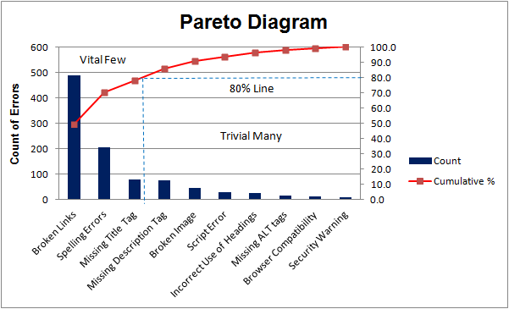
Techniques for CAR - Pareto Analysis
A tool to determine the “vital few” out of the “trivial many” possible causes to a given problem
80-20 rule – “20% of the causes account for 80% of the problems”
Possible Causes

Slide 23
Techniques for CAR - Pareto Analysis
Answers the following questions:
What are the largest issues facing our team or business?
Which 20% of sources are causing 80% of the problems (80/20 Rule)?
Where should we focus our efforts to achieve the greatest improvements?
Possible Causes

Slide 24
Techniques for CAR - 5-Why Technique
An iterative interrogative technique used to determine the root cause of a problem or a defect.
My tea was cold
Why was my tea cold?
Why didn’t the kettle heat the water?
Why was the fuse in the plug blown?
Why was an incorrect rated fuse fitted?
Why was the correct fuse not specified?
The kettle didn’t heat the water
No power-the fuse in the plug was blown
An incorrect rated fuse was fitted
The required fuse was not specified
There was no specification for fuses

Slide 25
Techniques for CAR - Fishbone analysis
Known as Fishbone Diagram/Ishikawa Diagram/Cause-and-Effect Diagram.
A tool used to identify all the possible root causes of a problem or defect.
Fishbone Diagram – Server Crashes
Method
Policies
Use of API Codes
Lotus Script Coding
Agent Scheduling
Java Coding
Main Server Downtime
Improper Handling and Management of Server
Antivirus Software Issues
Overloaded Web Server
Use of Third-Party Tools
Issues with the Domain Name Server
System Bugs
Other Issues
Technology

Slide 26
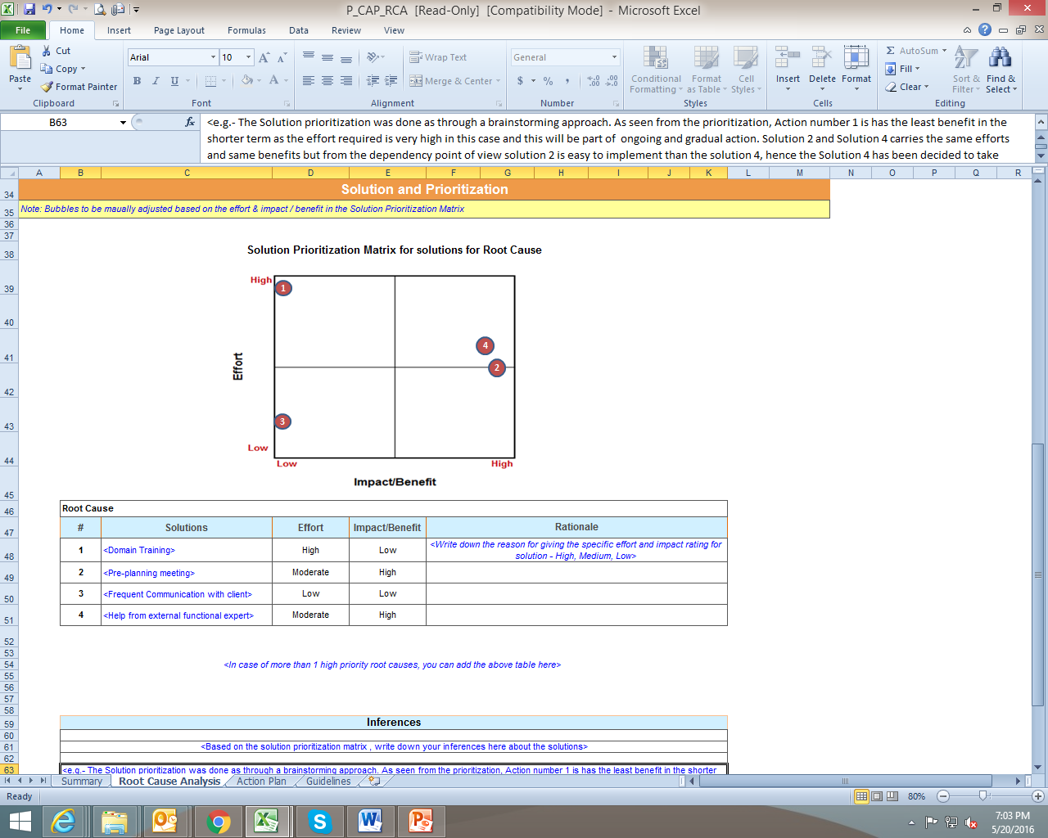
Fishbone analysis - Solution and Prioritization Matrix
Used to arrive at a consensus to a set of proposed solutions.
Used to prioritize the solutions proposed to be implemented for the identified root causes of the given problem.

Slide 27

Involvement of Developers in various processes : Horizontal Processes
Copyright © 2020 Cybage Software Pvt. Ltd. All Rights Reserved. Cybage Confidential.
www.cybage.com
27

Slide 28

Horizontal Processes
Software Configuration Management
Know and follow the folder structure in repository
Understand and use the naming conventions
Ensure to mention check-in/ check-out comments
Ensure to baseline the required artifacts (Label/Tag)
Ensure the right artifacts are available for the entire team
Tools for Software Configuration Management : TFS, CVS, SVN, Perforce

Slide 29

Horizontal Processes
Resource Management
Participate in the ramp-up activity for the new joiners
Participate in the handover and takeover activity (if triggered)

Slide 30

Horizontal Processes
Decision Analysis & Resolution(DAR)
Participate in decision making by providing:
Possible Alternative solutions
Providing rational (Pros/Cons)
POC/Analysis of risk involved in selected solution
Few techniques for conducting DAR:
Decision Matrix
Force-Field Analysis
Brainstorming

Slide 31
Commonly used Development Metrics
Metrics | Formula
Code coverage% | (No. of lines of code covered by automated unit tests/Total Lines of code) * 100
Unit Testing % | [Unit Test Case Execution Efforts (Hrs.)/Total Coding Efforts (Hrs.)] * 100
Code Review % | [Coding Review Efforts(Hrs.)/Total Coding Efforts (Hrs.)] * 100
% Quality Kick-back | (No. of Rejected work items/No. of Delivered work items) * 100
% Velocity Achieved | (# Story Points Completed/# Story Points Committed) * 100

Slide 32
Other Responsibilities
Discuss doubts & queries with client, PM or other stakeholders
Regularly attend client calls
Ensure clarity by providing reports on time
Participate in team meetings
Coordinate with QA team
Ensure to log your timesheet correctly
Participate in audits as auditee
NOTE : Always follow the Process; it’s a need, NOT A Fancy!

Slide 33

Walkthrough of Templates
Requirement Phase | Design Phase | Coding Phase | Build and Release Phase | Deployment Phase | Maintenance Phase

Slide 34

Any Questions?
www.cybage.com
34

Slide 35
Quick Test !
Understanding of requirements is done using?
Definition of functional & non-functional requirements is done using?
What is RTM?
List some design artifacts/tools available in Q@Core?
What is the purpose of writing UTCs?
What are various types of builds defined in Q@Core?
What are different estimation techniques?
What is developers’ involvement in CAR process?
What are the techniques under DAR?
What is developers’ involvement in configuration management?
What is change management process?
Notes:
RUD, seek answers from the audience
SRS
Requirement Traceability Matrix-captures all requirements proposed by the client or software development team and their traceability in a single document delivered at the conclusion of the life-cycle.
AD/SSLD/UID
UTCs help in ensuring coverage of multiple scenarios, gives an assurance of defect-free code for further phases
Internal build – That is for QA team only
Client Release - That is to be released to client
Patch/Hot Fix – Patch fixes for internal QA and/or for customer

Slide 36


Thank You!
12/1/2020
www.cybage.com
36
Copyright © 2018 Cybage Software Pvt. Ltd. All Rights Reserved. Cybage Confidential.

